Slide 1
Chapter two
Basic elements of c++

Slide 2
Introduction
C++ is a cross-platform language that can be used to create high performance applications.
C++ was developed by Bjarne Stroustrup, as an extension to the C language.
C++ gives programmers a high level of control over system resources and memory.
The language was updated 3 major times in 2011, 2014, and 2017 to C++11, C++14, and C++17.
C++ is one of the world's most popular programming languages.
C++ can be found in today's operating systems, Graphical User Interfaces, and embedded systems.
C++ is an object-oriented programming language which gives a clear structure to programs and allows code to be reused, lowering development costs.

Slide 3
Structure of C++ Program
A C++ program has the following structure
Comments
Preprocessor directives
Global variable declarations
Prototypes of functions
Definitions of functions

Slide 4
C++ IDE
The complete development cycle in C++ is:
Write the program,
compile the source code,
link the program, and
run it.
Writing a Program:
To write a source code you need to use
built-in text editor by compiler / Windows Notepad, the DOS Edit command/
commercial text/ WordPerfect, Word, and dozens/
The files you create with your editor are called source files, and for C++ they typically are named with the extension .CPP.

Slide 5
…
Compiling
Your source code file can't be executed, or run, as a program can.
To turn your source code into a program, you use a compiler.
After your source code is compiled, an object file is produced.
This file is often named with the extension .OBJ.
This is still not an executable program, however. To turn this into an executable program, you must run your linker.
Linking
C++ programs are typically created by linking together one or more OBJ files with one or more libraries
A library is a collection of linkable files that were supplied with your compiler.
All C++ compilers come with a library of useful functions (or procedures) and classes that you can include in your program.
A function is a block of code that performs a service
such as adding two numbers or printing to the screen.
A class is a collection of data and related functions.

Slide 6
Showing Sample program
Any meaningful program written in C++ has to contain a number of components: the main function; some variable declarations; and some executable statements.
For example, the following is a very basic C++ program:
1: #include <iostream.h>
2:
3: int main()
4: {
5: cout << "Hello World!\n";
6: return 0;
7: }
On line 1:
the file iostream.h is included in the file
The first character is the # symbol, which is a signal to the preprocessor
Each time you start your compiler, the preprocessor is run.
The preprocessor reads through your source code, looking for lines that begin with the pound symbol (#), and acts on those lines before the compiler runs.

Slide 7
…
Include
is a preprocessor instruction that says, "What follows is a filename. Find that file and read it in right here."
The angle brackets around the filename tell the preprocessor to look in all the usual places for this file.
If your compiler is set up correctly, the angle brackets will cause the preprocessor to look for the file iostream.h in the directory that holds all the H files for your compiler.
The file iostream.h (Input-Output-Stream) is used by cout and cin, which assists with writing to the screen and inserting user inputs respectively
Line 3
begins the actual program with a function named main().
Every C++ program has a main() function.
When your program starts, main() is called automatically
main(), like all functions, must state what kind of value it will return.
The return value type for main() in HELLO.CPP is int, which means that this function will return an integer value.

Slide 8
…
All functions begin with an opening brace ({) and end with a closing brace (}) on lines 4 and 7.
Everything between the opening and closing braces is considered as part of functions.
The object cout is used in C++ to print strings and values/messages to the screen
type the word cout, followed by the output redirection operator (<<).
Whatever follows the output redirection operator is written to the screen.
If you want a string of characters written, be sure to enclose them in double quotes ("), as shown on line 5.
A text string is a series of printable characters
The main() function ends on line 7 with the closing brace
The final two characters, \n, tell cout to put a new line after the words Hello World!

Slide 9
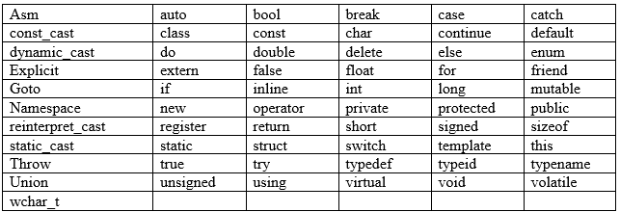
Basic Elements
Keywords (reserved words)
Reserved/Key words have a unique meaning within a C++ program.
These symbols, “the reserved words”, must not be used for any other purposes.
All reserved words are in lower-case letters.
The following are some of the reserved words of C++.

Slide 10
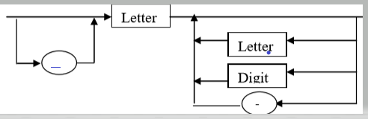
Identifiers
An identifier is name associated with a function or data object and used to refer to that function or data object
An identifier must:
Start with a letter or underscore
Consist only of letters, the digits 0-9, or the underscore symbol _
Not be a reserved word
the use of two consecutive underscore symbols, _ _, is forbidden.
Syntax of an identifier

Slide 11
…
The following are valid identifiers
The following are invalid:

Slide 12
…
At this stage, it is worth noting that C++ is case-sensitive. That is lower-case letters are treated as distinct from upper-case letters.
the word NUM different from the word num or the word Num.
Identifiers can be used to identify variable or constants or functions.
Function identifier is an identifier that is used to name a function.

Slide 13
Con…
Literals
Literals are constant values which can be a number, a character of a string.
Eg: the number 129.005, the character „A‟ and the string “hello world” are all literals.
There is no identifier that identifies them.
Comments
A comment is a piece of descriptive text which explains some aspect of a program.
Program comments are totally ignored by the compiler and are only intended for human readers.
C++ provides two types of comment delimiters:
Anything after // (until the end of the line on which it appears) is considered a comment.
Anything enclosed by the pair /* and */ is considered a comment.

Slide 14
#include<iostream.h>
int main()
{
//this is a comment
int n=10; //valid variable declaration
cout<<“my first variable declaration” <<endl;
cout<<n;
return 0;
}

Slide 15
Data Types, Variables, and Constants
Variables
A variable is a symbolic name for a memory location in which data can be stored and subsequently recalled.
Variables are used for holding data values so that they can be utilized in various computations in a program.
All variables have two important attributes
1. A type
which is, established when the variable is defined (e.g., integer, float, character).
Once defined, the type of a C++ variable cannot be changed.
2. A value
which can be changed by assigning a new value to the variable.
The kind of values a variable can assume depends on its type.
For example, an integer variable can only take integer values
e.g., 2, 100, -1 not real numbers like 0.123.

Slide 16
…
Variable Declaration
Declaring a variable means defining (creating) a variable.
You create or define a variable by stating its type, followed by one or more spaces, followed by the variable name and a semicolon
Good variable names tell the function of the variable
using good names makes it easier to understand the flow of your program.
e.g, int myAge;
Creating More Than One Variable at a Time
You can create more than one variable of the same type in one statement by writing the type and then the variable names, separated by commas.
int myAge, myWeight; // two int variables
long area, width, length; // three longs
IMPORTANT- Variables must be declared before used!

Slide 17
…
Assigning Values to Your Variables
You assign a value to a variable by using the assignment operator (=).
Thus, you would assign 5 to Width by writing
int Width;
Width = 5;
Or
int Width = 5;
Reading assignment
Basic Data Types
Signed and Unsigned
Characters

Slide 18
Operators
Assignment Operators
The assignment operator is used for storing a value at some memory location means variable.
Its left operand should be an lvalue,
denotes a memory location
its right operand may be an arbitrary expression.
Examples
int m, n, p;
m = n = p = 100; // means: n = (m = (p = 100));
m = (n = p = 100) + 2; // means: m = (n = (p = 100)) + 2;

Slide 19

Assignment operator example
Code
Output
#include<iostream.h>
int main()
{
intn=10;
cout<<“n=“<<n;
return 0;
}
n=10

Slide 20
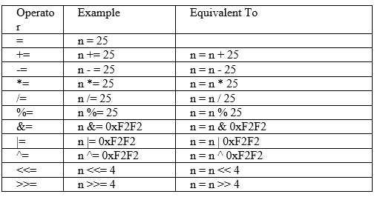
…

Slide 21
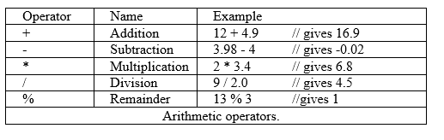
…
Arithmetic Operators
C++ provides five basic arithmetic operators.

Slide 22
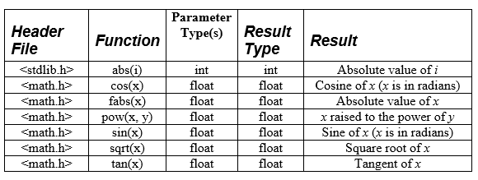
…
arithmetic operations defined by C++ library
Nb: if you want to use these you must put a #include statement at the start of your program

Slide 23
Examples of arithmetic operations defined by C++ library
#include<iostream.h>
#nclude<math.h>//including c++ library
int main()
{
float n=10;
float m=cos(n);
Cout<<“cosin of 10 is =“<<m;
return 0;
}
cosin of 10 is =-0.839072

Slide 24
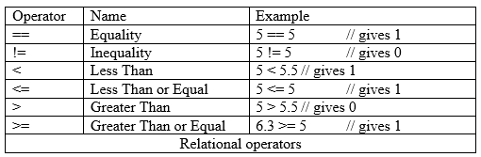
…
Relational Operators
Used for comparing numeric quantities.

Slide 25
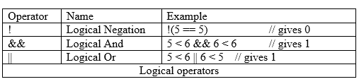
…
Logical Operators
Used for combining logical expression

Slide 26
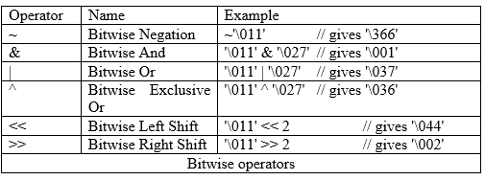
…
Bitwise Operators

Slide 27
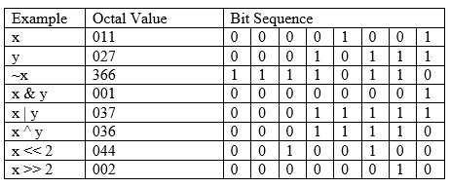
…
Example

Slide 28
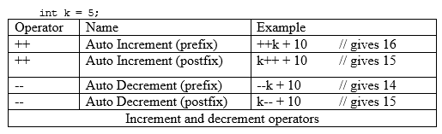
…
Increment/decrement Operators

Slide 29
Increment operator example
#include<iostream.h>
int main()
{
int x=10, y=15;
cout<<“pre_increment of x is=“<<++x;
cout<<endl;
cout<<“post_increment of y is=“<<y++;
return 0;
}
#include<iostream.h>
int main()
{
int x=10, y=15;
cout<<“pre_increment of x is=“<<++x;
cout<<endl;
cout<<“post_increment of y is=“<<y++;
return 0;
}

Slide 30
Lab exercise
Write c++ programs for the following problems
1. displaying hello world
2. addition of numbers
3. area of a circle using user input data
4. value swapping between variable using third variable
5. that will calculate simple interest

